Slide 1



Building Websites that Look Great on Any Device
Responsive Web Design
Eligijus Petrikonis, SEB

Slide 2


INTRODUCTION
Eligijus Petrikonis
Senior solution (Full-stack)developer
Bachelor's degree from VGTU
Started as a Project Coordinator during the 3rd course
Almost 8 years at SEB, with nearly 12 years of experience as a developer.
Besides development, CrossFit is my main hobby.
I’m not designer
Notes:
The first time I laid my hands on a PC was when I was 9 years old. At that time, I had no idea that I would end up working as a developer. I completed my studies at VGTU, focusing on IT, and earned a bachelor's degree.
During my third year of studies, I began working as a Project Coordinator. However, after the trial period, I decided to embark on a new career within the same company as a Front-end developer.
After four years, SEB invited me to discuss an open Front-end developer position. Since then, I have been working at SEB for nearly 8 years as a Full-stack developer.
My journey at SEB has been diverse and colorful. I have gained expertise in various areas, ranging from front-end and back-end development to manual and automated testing, as well as exploring requirements and serving as a Scrum Master.
To avoid being typecast as just a developer and to continue my personal growth, about four years ago I started practicing CrossFit. It quickly became my main hobby, and I have grown to love it.
Why do I enjoy being a developer? It's because I am constantly amazed by the process of creating functional applications from scratch, starting from 0 lines of code.

Slide 3
Who are you?
Where are you from?
How much experience related with Front-end development?
Have you tried something
related with responsive design?
Notes:
Answer questions in chat, we can get more familiar who and how much experience joined in this session

Slide 4
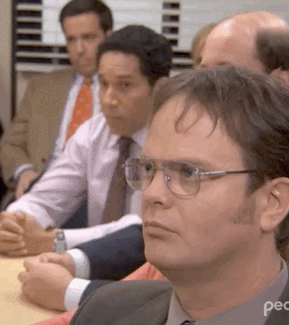
Questions
Write your questions in chat
Will be Q&A session in the end also
Notes:
To easier follow questions let’s agree to write them in the chat, I will try to check them frequently. Also, in the end of this session we will have Q&A part.

Slide 5

How looks my day at work?
Support environments
Mail reading
chatting in teams
MEETINGS
???% Actual development
Notes:
So how looks my average day in work. Because of having more experience and knowledge so my main priority is to support environments beginning from PROD and ending to SBX after that is to answer mails for open questions and to participate in the meetings. And if some time lefts so then it’s time for development which some days could reach ~90% and some only ~10%.

Slide 6

Agenda
Responsive design fundamentals
Bad/good design solutions
Let’s touch some code
Useful material
Q&A
Wrap up

Slide 7
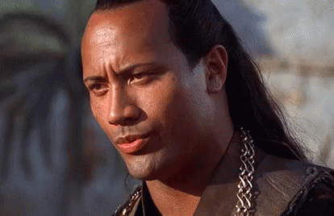


NEEDED TECHNOLOGIES
Notes:
Mandatory technologies and knowledge to work with responsive.
Mostly and most recommended is to use only html and css as much as possible,
some animation after mouse event needed so then you probably will need to use JS also

Slide 8
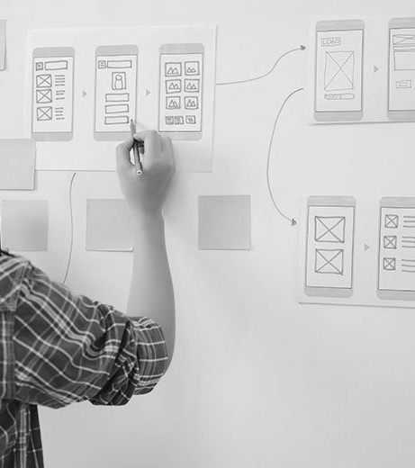

UX/UI designer
should be your friend
Or you should have design sense
Notes:
We as developers usually doesn’t have good design sense and in this case we need to have designer friend to have ability to ask questions how it should look in any device and designer should provide all needed details regarding spaces, sizes and etc.

Slide 9
What is (RWD)?
Responsive web design (RWD) is a web design approach to make web pages render well on all screen sizes and resolutions while ensuring good usability.
HTML is fundamentally responsive
Responsive web design isn't a separate technology — it is an approach.

Slide 10
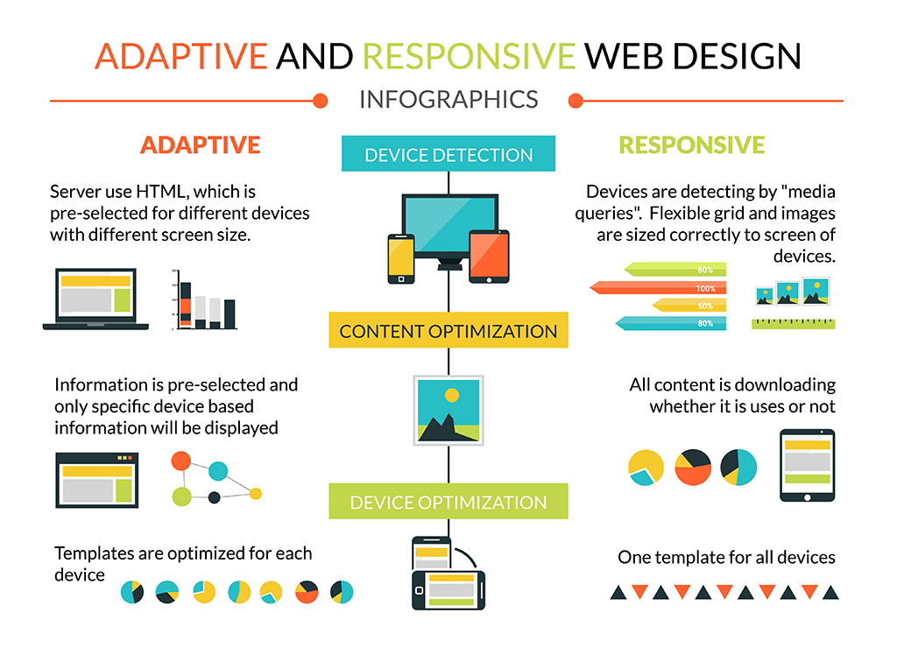
Adaptive vs responsive
Notes:
Differences
Adaptive
Pros: Optimised and best performance
Cons: A lot of development needed to prepare multi templates
Responsive
Pros: Same one template, just show/hide elements
Cons: Loading everything, need to consider what is most needed for mobile devices also consider lazy loading

Slide 11
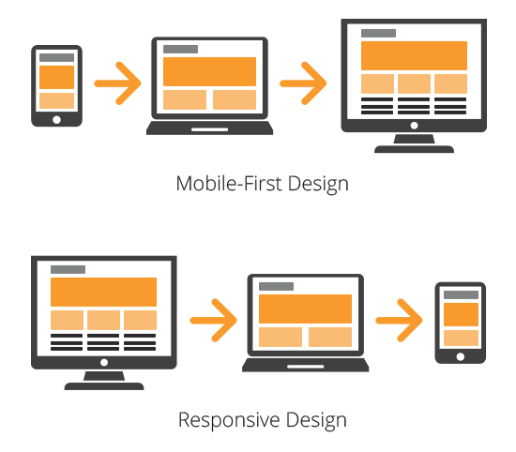
RWD approaches
Notes:
2 approaches how to make websites ersponsive
Old one:
Responsive(Dekstop first) approach
More preferrable to transform old websites to be responsive
Hiding, shrinking elements to fit smaller devices
New one:
Mobile first
Need to start think from smallest device to biggest
Harder in start but by time it’s easier to just show more stuff

Slide 12

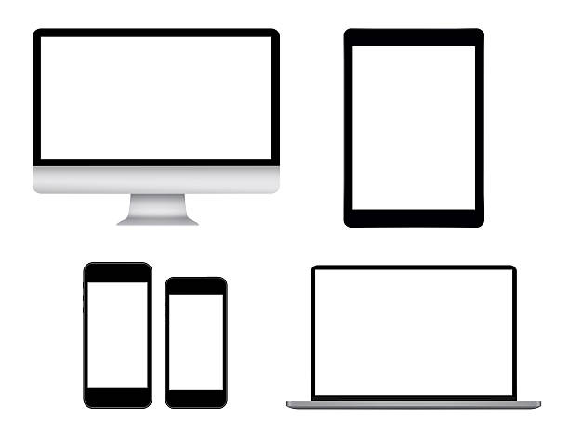
Screen sizes
Mobile: 360 x 640
Tablet: 768 x 1024
Laptop: 1366 x 768
High-res laptop or desktop: 1920 x 1080
Notes:
These are most common sreen viewport sizes in pixels
By these sizes usually creating design breakpoints where items shows/hides

Slide 13


CSS Units
Absolute
Relative
Pixels (px)
Inches (in)
Centimeters (cm)
Milimiters (mm)
Points (pt)
Picas (pc)
Percentages (%)
Font sizes (em, rem)
Viewport dimensions (vw, vh)
Viewport min/max (vmin/vmax)
Notes:
Main thing to think is that for responsive design to make elements to fit in screen is needed to use sizing units which reflects to root element viewport and root element widths
There are 2 types of units
Explain in short all of them

Slide 14


Font size RULE
Don’t make font size too small/big in any devices
Usually, it is ~16px size
Pretend to be as regular user
who will be reading that texts
Notes:
As we already know sizing units so other important thing is text size how big it should be to be readable in devices.
Text size also very depends from actual used font
If it regular font so on mobile devices recommendation is to use at least 16px
And for desktop around 16px
But if designer would say differently so you should try that size first of all

Slide 15



Css Frameworks
Mostly and widely used in the world
Styles based on Bootstrap but customized for SEB
Others like Tailwind, Foundation, Materialize
Notes:
In front end world there are a lot of framework same fits for css
So most popular css framework is Bootstrap
Inside you can find a lot of already defined css rules for all devices
In SEB we also using bootstrap but we customized it to have more SEB’ish styles
There are other frameworks as Tailwind, foundation and materialize, all frameworks tries to solve same case
Which is to provide easy way how to style html code

Slide 16

TOOLS for TESTS
Physical devices
Impossible to have all
100% real test results
Browser debug tools
Free to use
Easy to have all
Complex/specific device solutions not visible
Lighthouse to test performance
Emulator/simulator
Setup needed
Not cheap
Accurate test results
Notes:
Besides development we as developers need to test and verify what we are developing, same fit for responsive
There are several ways how to do it
Explain all of them

Slide 17
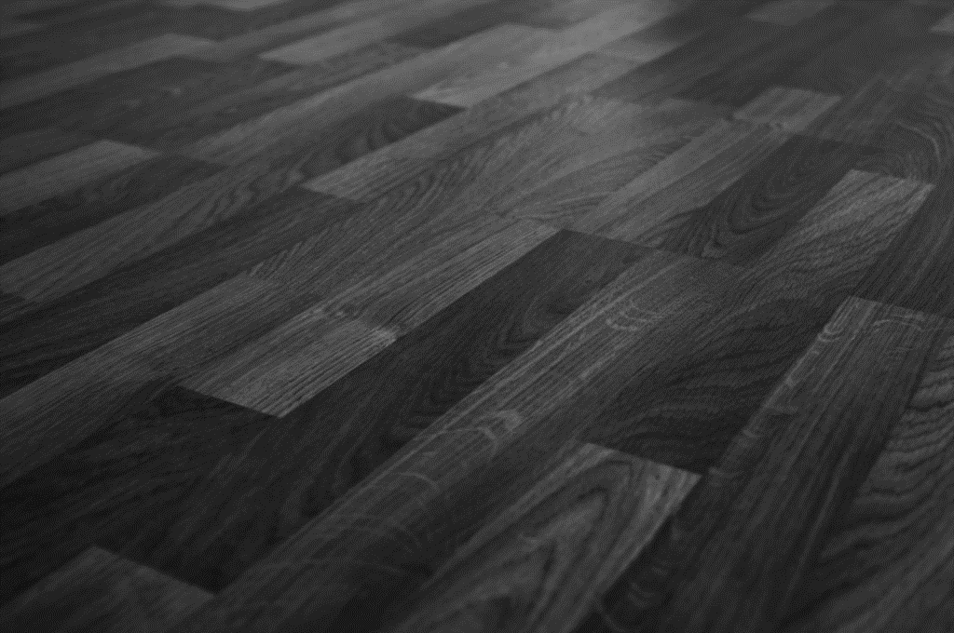
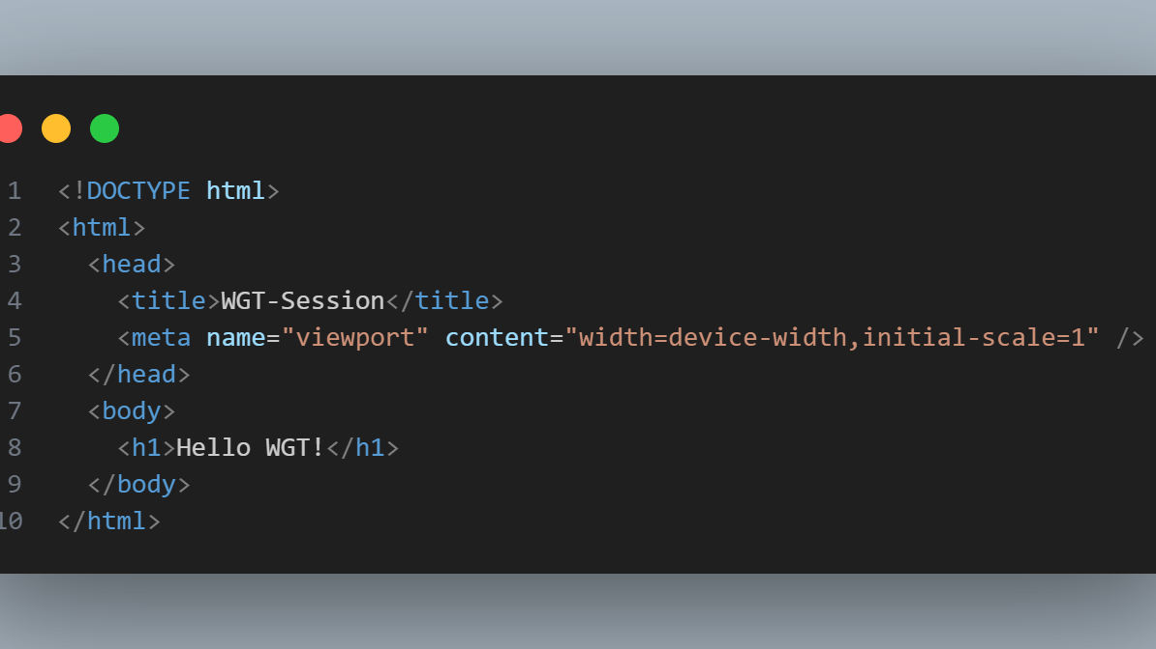
How to enable responsive design?
Notes:
This viewport meta tag tells mobile browsers that they should set the width of the viewport to the device width, and scale the document to 100% of its intended size, which shows the document at the mobile-optimized size that you intended.
Why is this needed? Because mobile browsers tend to lie about their viewport width.

Slide 18
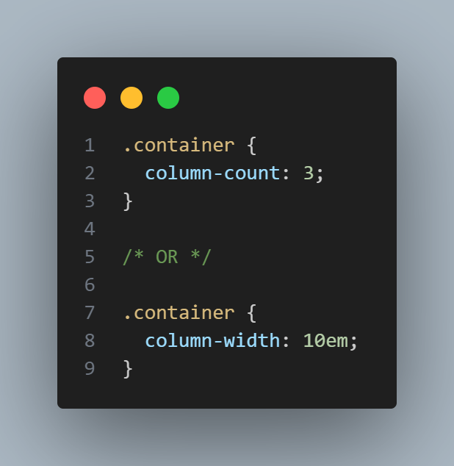
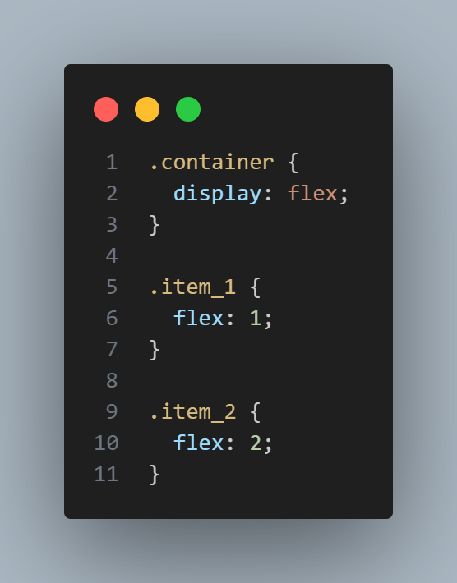
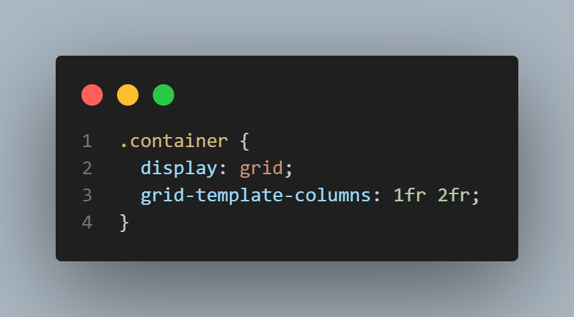
Responsive layout technologies
Responsive sites are built on flexible grids, meaning you don't need to target every possible device size with pixel perfect layouts.
Multicol
Flexbox
Grid
Notes:
Multicol
If you want to split element which holds big text to several same appearance columns
Flexbox and Grid
I personally used Flexbox, but googled Flex and grid differences and no major differences besides that Grid created from floating column idea.
Also from discussions and approaches how developers or framework chooses between them seems that flex is winner in this competition

Slide 19
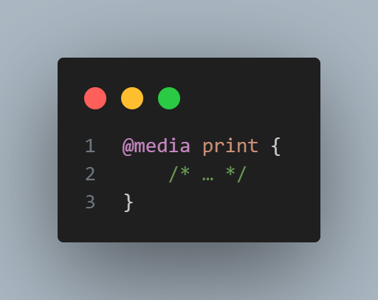
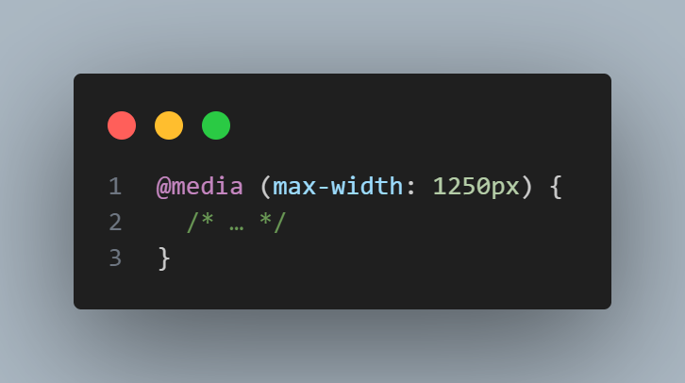
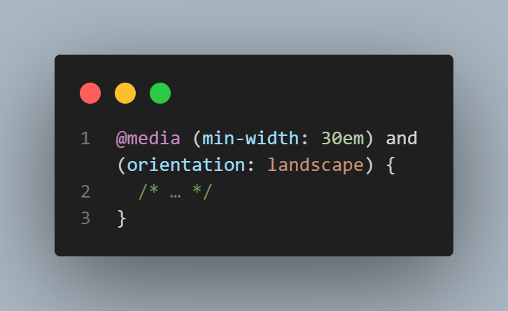
How to customize responsive design? Using media queries
Media queries allow you to apply CSS styles depending on a device's general type (such as print vs. screen) or other characteristics such as screen resolution or browser viewport width.
Media types
all
print
screen
Media features
(min-/max-)width
(min-/max-) height
orientation
Complex queries
Notes:
How we can control design differently on different devices and different orientations?
For this reason CSS have functionality called media queries
Media queries allows to write css rules which will be added/removed depending from rules
Explain differences

Slide 20
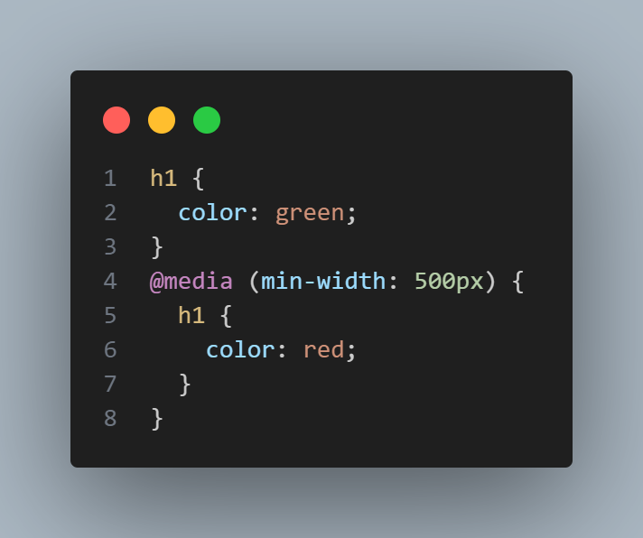
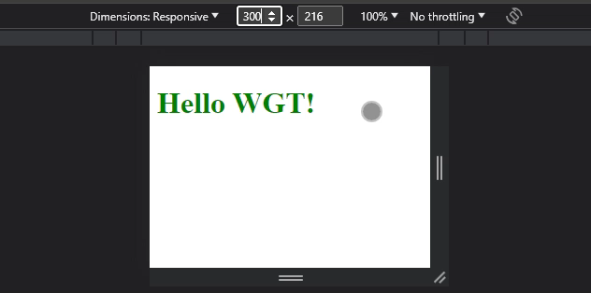
Notes:
Here is example how it looks

Slide 21


Slide 22
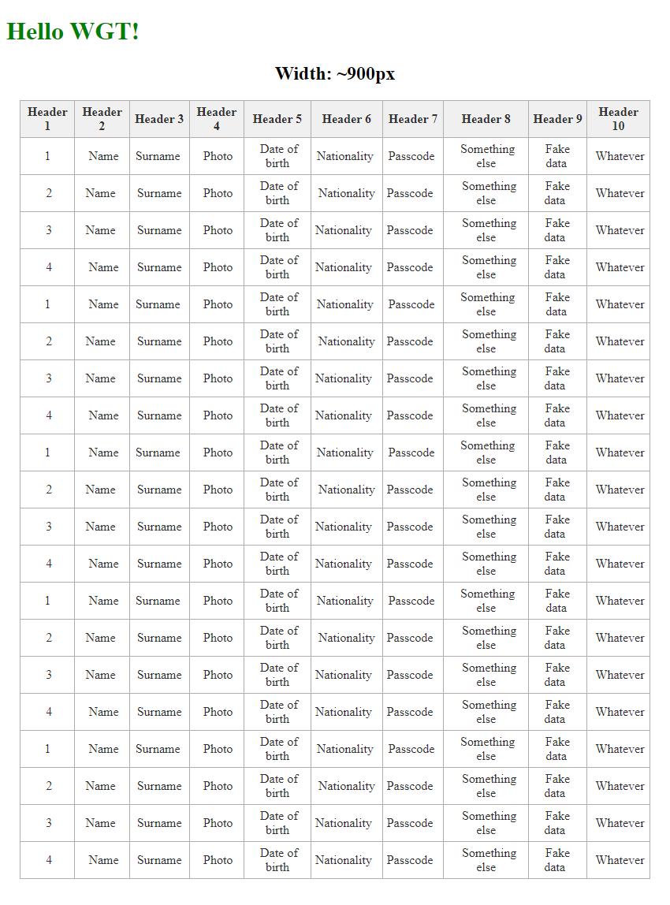
Question 1 (BIG TABLE)
Notes:
We have big table with 10 columns which fits in desktop but as you probably can guess it won’t fit in tablet or phone

Slide 23
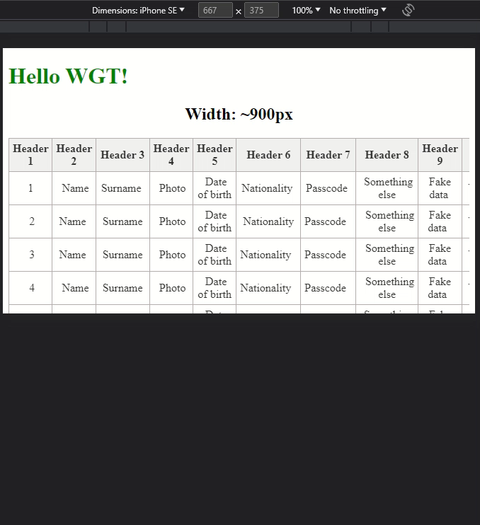
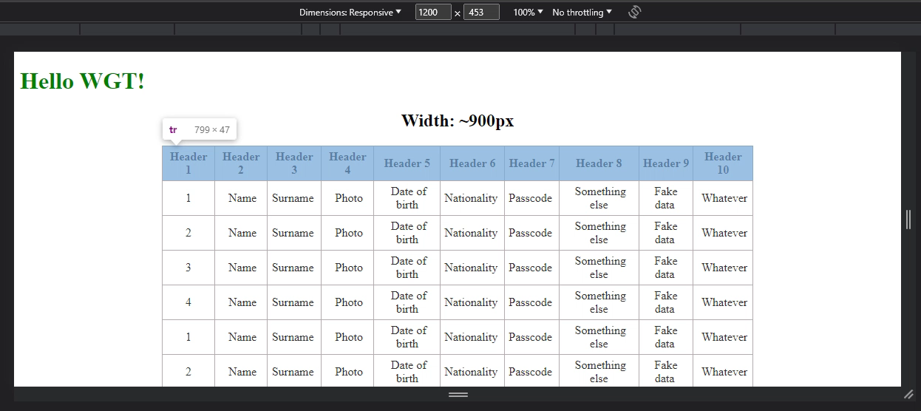
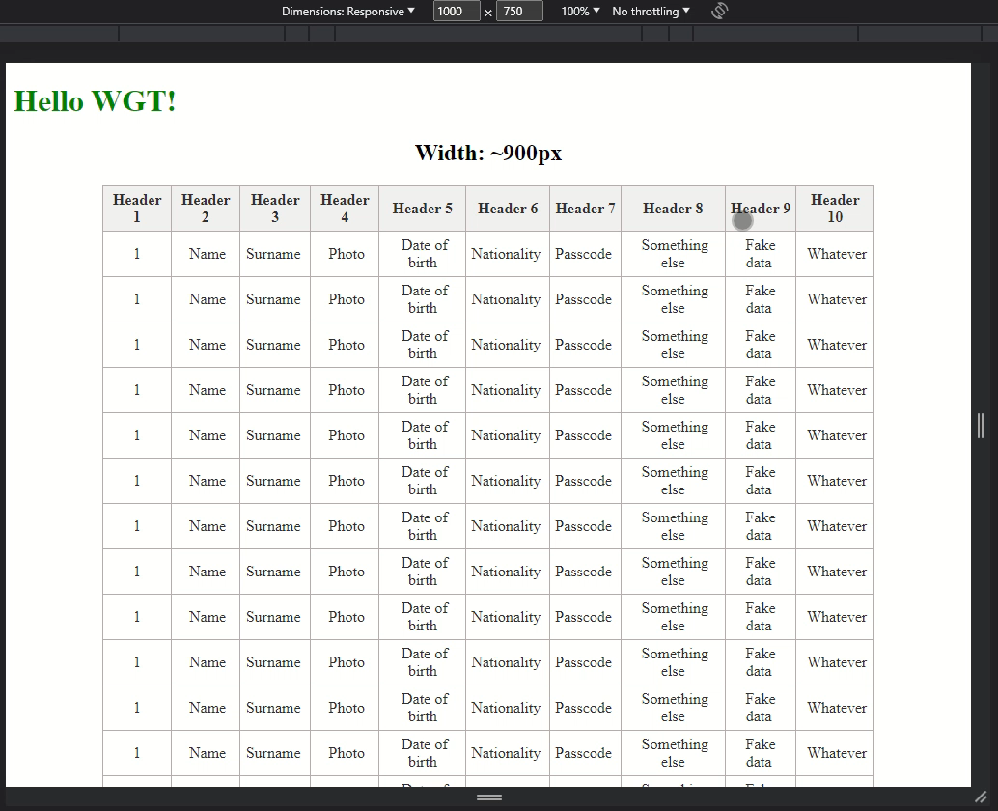
Answers
Option 1 Scroll
Option 2
Hide columns
Option 3
Transform to list
Notes:
There are 3 options, show all 3, and ask to choose.
Option 1:
Applicable
any kind of data
various types of content
Pros
easy to use
easy to develop
simplicity
Cons
limited space for data presentation
need to resign from part of the data
Option 2:
Applicable
for wide tables (3–8 columns)
for short tables (recommend to keep all height of the table above the fold)
Pros
easy to develop
easy to use
Cons
not for large amounts of content
the legend is not visible after scroll
Option 3:
Applicable
a huge amount of data
various types of content
Pros
useful with a huge amount of data and its size
ability to collapse and hide some data
a versatile form of data presentation
Cons
repetitive column names
hard to compare particular data between rows

Slide 24
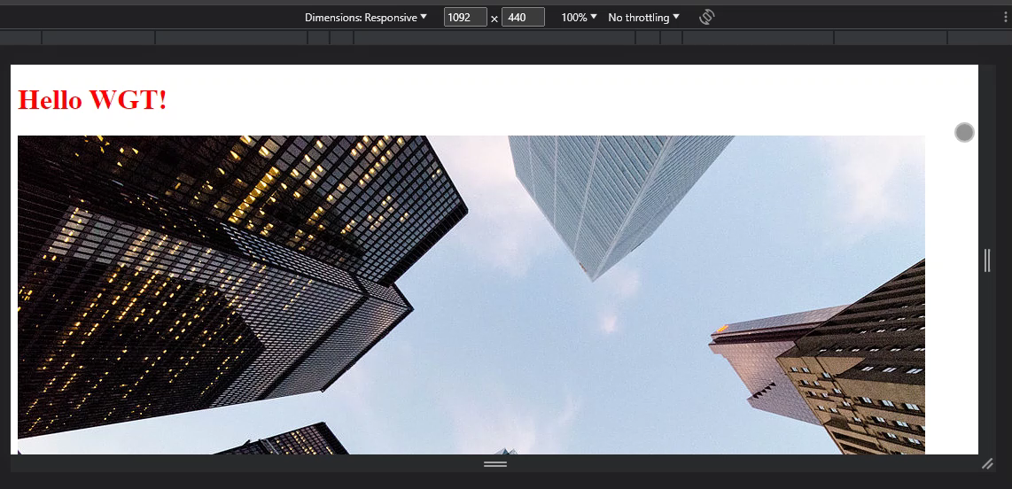
Question 2 (images)
Notes:
We have big image which doesn’t fit tablet and phone

Slide 25

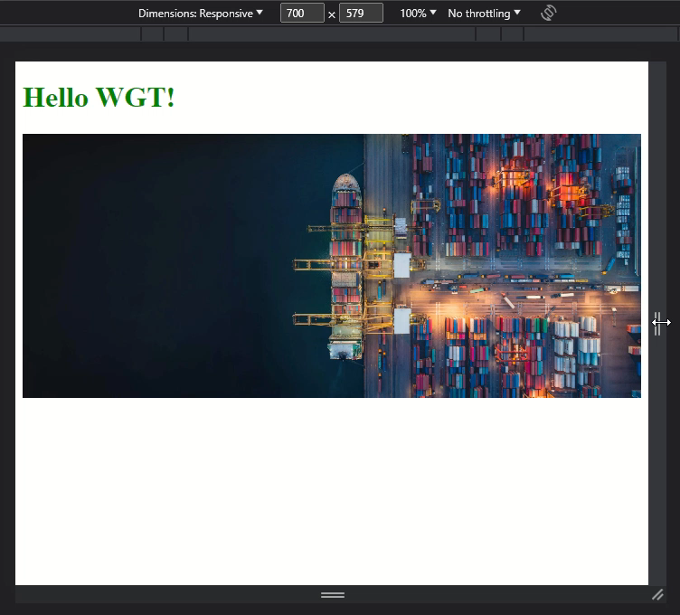
Answers
Option 1 Resizing
Option 2
Resizing and loading smaller/bigger versions
Notes:
Choose one of two
Option 1:
Pros
Same one image
Load once and show once
Cons
In mobile devices big images could request more resources than it would need to use for smaller versions
Option 2:
Pros
Improve performance
Cons
Need to prepare several versions of images

Slide 26
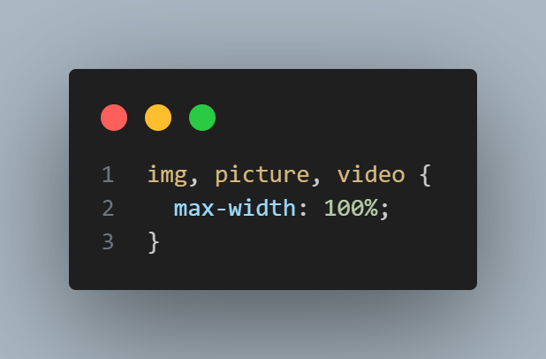
Responsive images
To ensure that images which should be big in desktop mode fits in mobile we need to add CSS
Before
After
Notes:
So how we should solve image responsiveness

Slide 27
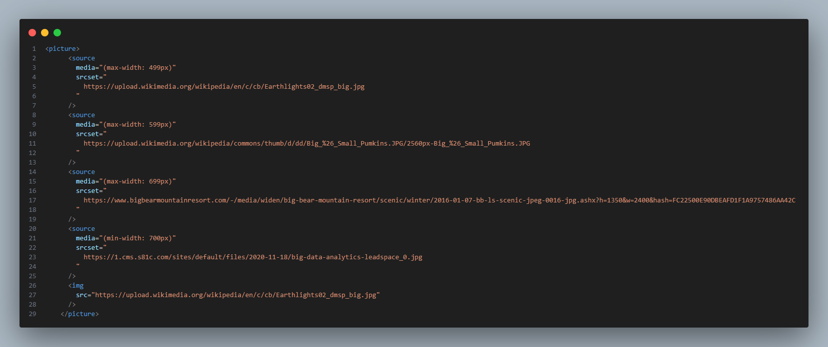
Improve performance of images
To reduce load in mobile devices it is good approach to load specific smaller images

Slide 28
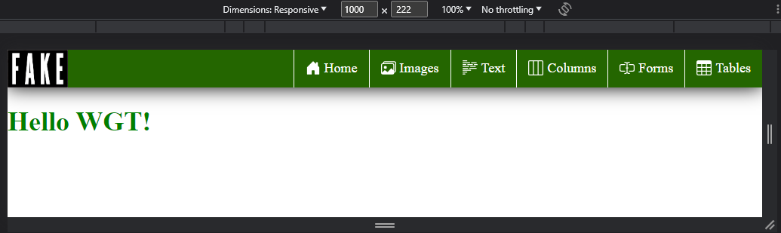
Question 3 (header)
Notes:
We have header of website with logo and menu inside

Slide 29
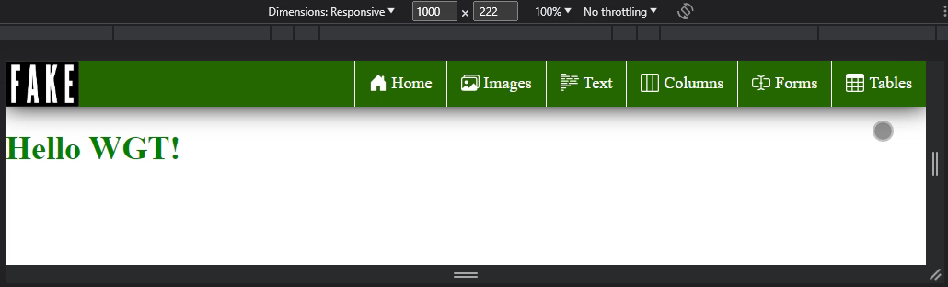
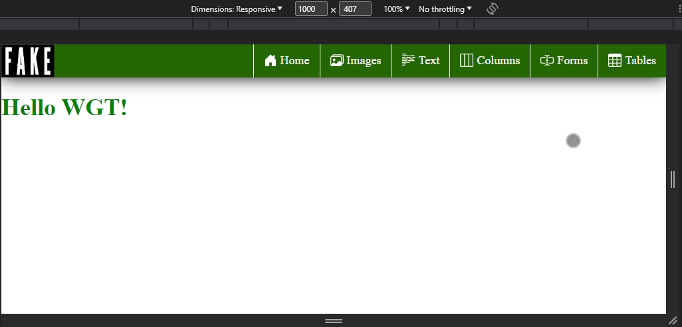
Answers
Option 1 Remove text
Option 2
Transform to “hamburger”
Notes:
Show solutions, ask to choose one
Option 1:
Pros
For small menu better to show menu and text if it fits
Cons
Need to have related icons if hiding text
Option 2:
Pros
Best for huge multi level menus
Showing texts and icons if needed
Cons
For huge menus need to review structure to easily find related info

Slide 30

Time for live coding
GIT Repo: https://github.com/eligijus-petrikonis/wgt-session

Slide 31


Useful material
Courses
Readings
https://www.pluralsight.com/courses/hands-on-responsive-web-design
https://www.codecademy.com/learn/learn-responsive-design
http://goodui.org/
https://getbootstrap.com/docs/5.3/examples/
https://developer.mozilla.org/en-US/docs/Web/CSS/CSS_media_queries/Using_media_queries#syntax
https://css-tricks.com/snippets/css/a-guide-to-flexbox/
https://css-tricks.com/how-to-develop-and-test-a-mobile-first-design-in-2021/
https://www.w3schools.com/css/css3_box-sizing.asp
Google of course everybody’s best friend ☺
Don’t forget also ChatGPT ☺

Slide 32
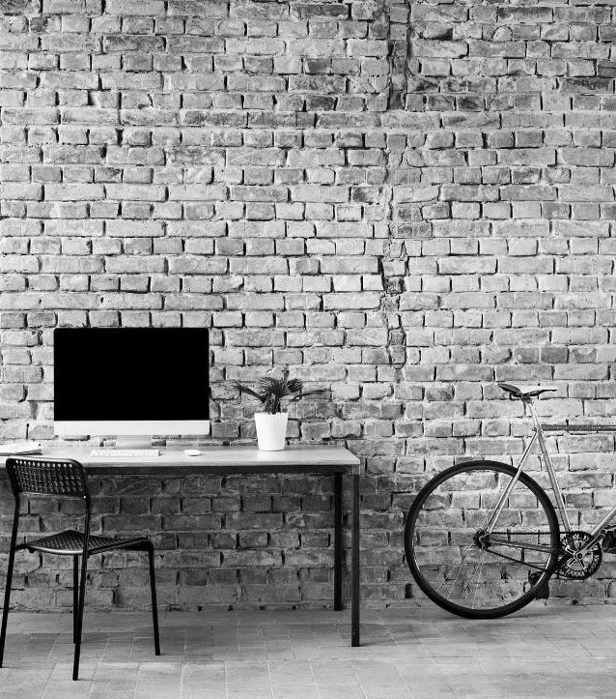
Q&A

Slide 33

Wrap up
Have a sense of design or be friends with a designer
Practice and test on all devices
Don't forget RWD fundamentals
Act as a regular user – consider whether it would be handy

Slide 34
THANK YOU 😀
BE CREATIVE OR ASK DESIGNER HOW IT SHOULD BE

